Slide 1

Corporate Default Prediction
A Probability of Default (PD) Model
Hamed Vosgha,PhD

Slide 2
Introduction
This project aims to predict the probability of corporate bankruptcy using logistic regression. The dataset contains financial indicators of public companies and labels indicating bankruptcy status.

Slide 3
Dataset Used for Probability of Default (PD) Modeling
Reference:
The dataset selection is guided by insights from the paper "Datasets for Advanced Bankruptcy Prediction: A Survey and Taxonomy" by Xinlin Wang et al. This paper provides a detailed taxonomy of datasets commonly used in bankruptcy prediction research.
Contains accounting data for 8,262 companies over the period 1999 to 2018. Provides 78,682 firm-year observations labelled as 1= Bankruptcy (failed companies), 0 = Alive (non-failed companies)
This dataset was used to build, train, and evaluate PD models, focusing on improving prediction accuracy, especially for rare events like defaults.

Slide 4
Addressing Imbalanced Data: Enhancing Bankruptcy Prediction Accuracy with SMOTE
Challenge | The dataset was highly imbalanced, with significantly more non-defaulting companies (alive) than defaulting ones (failed).
 | This imbalance can skew model predictions toward the majority class, reducing the effectiveness of predicting defaults.
Solution | - Oversampling with SMOTE (Synthetic Minority Oversampling Technique):
 | - Generated synthetic samples for the minority class to balance the training dataset.
 | - Resulted in equal representation of both classes during model training.
Results | - Enhanced the model's ability to identify default cases while preserving the overall predictive power for non-default cases.
 | - Improved the Recall for the minority class (defaults), which is crucial in bankruptcy prediction.

Slide 5
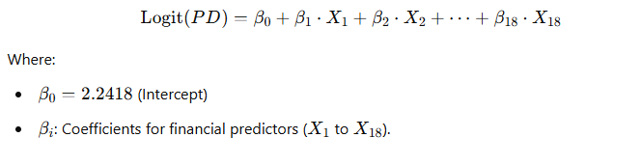
Logistic Regression Model for PD Prediction
Model Overview:
Purpose: Predict the likelihood of company default (1 = Bankruptcy, 0 = Alive).
Technique: Logistic Regression, a simple yet effective binary classification model.
Model Equation:
Model Performance:
Test ROC AUC Score: 0.742
Validation ROC AUC Score: 0.711
Optimal Threshold: 0.92

Slide 6
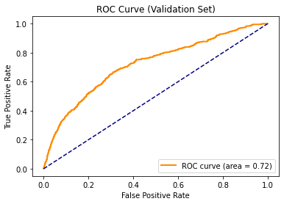
Optimised Model Performance
Validation Set Evaluation (Optimised Threshold):
Accuracy: 90%
Precision (Default): 16%
ROC AUC: 0.72
Test Set Evaluation:
Accuracy: 90%
Precision (Default): 16%
ROC AUC: 0.7423

Slide 7
Key Insights and Next Steps
Key Insights:
- Optimized threshold significantly improves precision and recall.
- Financial indicators like Retained Earnings and Leverage Ratio are critical.
Next Steps:
- Experiment with advanced models (e.g., Random Forest, Gradient Boosting).
- Further analyze segmentation and outliers.

Slide 8
Summary of PD Models | SME & Corporate s
Model Type | Key Features | Best Use Case
Logistic Regression | - Simple, interpretable, regulator-friendly. | Default prediction for SMEs using financial ratios.
 | - Suitable for smaller datasets or when interpretability is critical.
 | - Assumes linear relationships between predictors and log-odds of default.
Tree-Based Models | - Handles non-linearity and complex interactions effectively. | Predicting defaults for complex corporate portfolios.
 | - Provides superior predictive accuracy.
 | - Algorithms: Random Forest, Gradient Boosting (e.g., XGBoost, LightGBM).
 | - Requires more computational resources and is less interpretable.
Survival Analysis | - Models time-to-event data, accounting for the dynamic nature of default risk over time. | Dynamic portfolios with varying risk over time.
 | - Captures evolving default probabilities with covariate effects.
 | - Algorithms: Cox Proportional Hazards, Kaplan-Meier Estimator, Accelerated Failure Time (AFT).

